Slide 1

SUMMER TRAINING INTERNSHIP

Slide 2

Database Management System & SQL from Board Infinity

Slide 3
Submitted by Name : Gopu Shanmukha Datta Registration no : 12107780 Under the Guidance of Mr. Souvik Aditya

Slide 4
INTRODUCTION

Slide 5

In today's digital landscape, data reigns supreme, driving decision-making, innovation, and the success of organizations worldwide. Yet, the sheer volume and complexity of data pose significant challenges without effective management. In this presentation, we delve into the critical world of DBMS and SQL, exploring how these foundational components empower us to efficiently store, organize, retrieve, and manipulate data.

Slide 6
Objective

Slide 7

1. Objective: Database Design and Implementation Create tables to store product information, user data, order details, and customer reviews. Develop an efficient schema that supports data integrity, and implement SQL queries to retrieve product recommendations based on user preferences. 2. Objective: Performance Optimization and Querying Optimize the performance of an existing customer database for a subscription-based service. Identify slow-performing queries and use indexing and query optimization techniques to enhance response times. Develop complex SQL queries to generate monthly usage reports for individual customers and provide insights for business decisions

Slide 8
Significance
Efficient Data Management
Business Intelligence and Data Analysis
Application Development
Data-Driven Marketing
E-Commerce and Online Transactions
Healthcare Informatics
Financial Services and Banking
Supply Chain Management
Educational Institutions
Research and Scientific Data

Slide 9
Brief Description of the Work Done
HR Database Exploration and Querying :
During the course with a real-time project at Board Infinity, I had the privilege to delve into the intricacies of the HR Database. This database, originally created by Microsoft, served as an invaluable resource for learning and applying Database Management System (DBMS) and Structured Query Language (SQL) skills.
Activities/Equipment Handled :
- Explored the database schema to comprehend the relationships among tables.
- Executed SQL queries to retrieve specific information from different tables.
- Utilized query optimization techniques to enhance query performance.

Slide 10
OUTPUTS

Slide 11
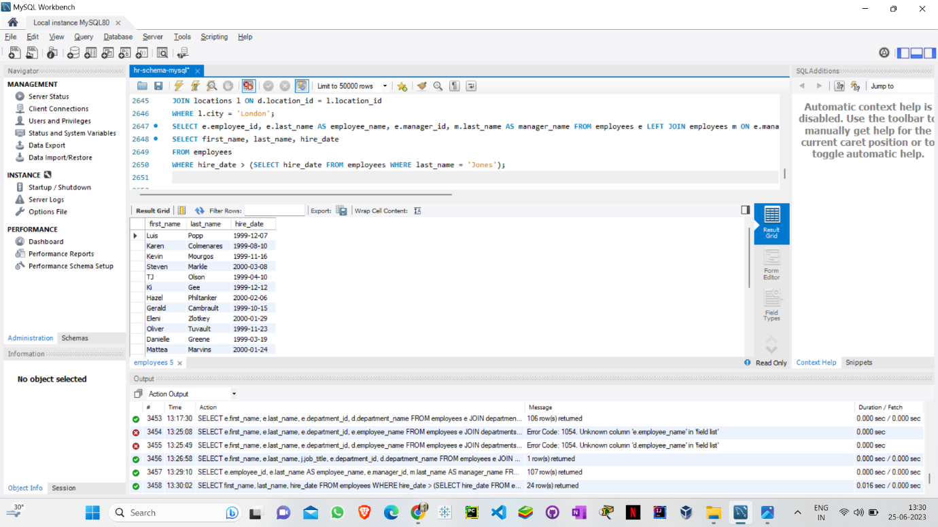
1. Write a query to find the name (first_name, last_name) and hire date of the employees who was hired after 'Jones'

Slide 12
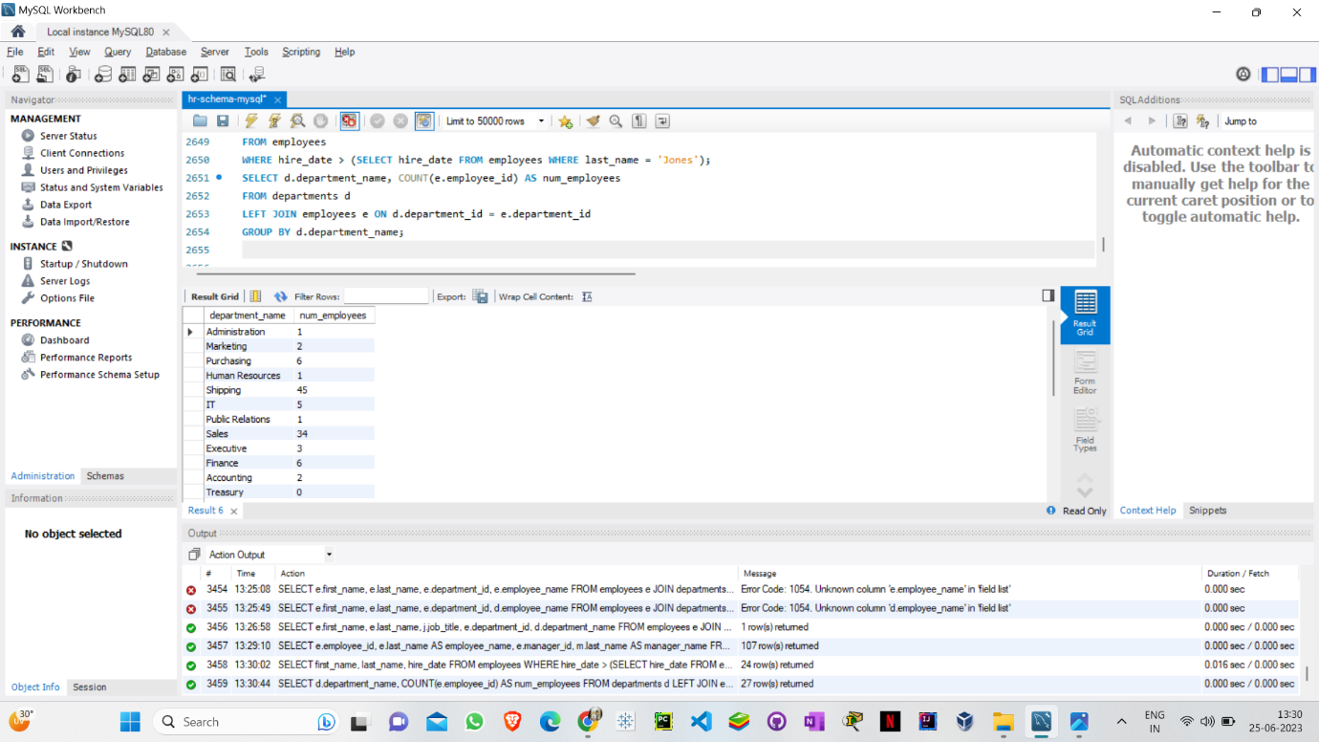
2. Write a query to get the department name and number of employees in the department

Slide 13
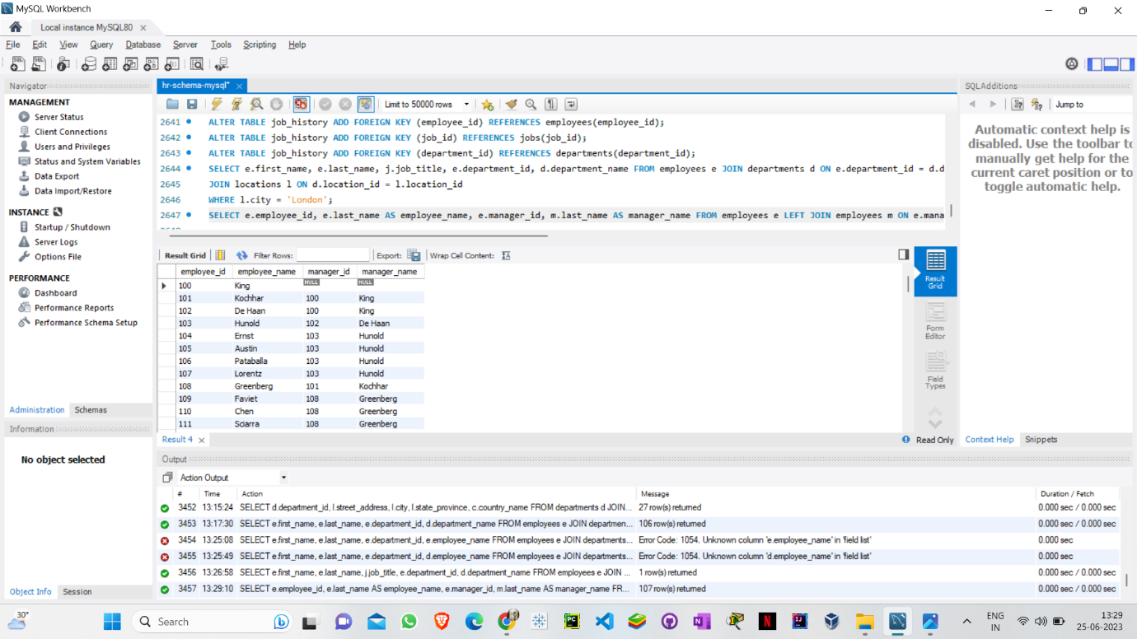
3. Write a query to find the employee id, name (last_name) along with their manager_id and name (last_name)

Slide 14

Conclusion
In traversing the realms of the HR Database through the course with a real-time project at Board Infinity, I've embarked on a transformative journey that has left an indelible mark on my understanding of Database Management System (DBMS) and Structured Query Language (SQL). This expedition has underscored the significance of practical learning and equipped me with an arsenal of skills that transcend the confines of a mere curriculum.

Slide 15
References
https://www.boardinfinity.com/
https://www.w3schools.com/
https://www.geeksforgeeks.org/

Slide 16


❣️

